Slide 1


Introducing
VIENZO.
A Professional Infographic Statistic Presentation Template
2022

Slide 2


PROFESSIONAL
INFOGRAPHIC
STATISTIC
About us
Greeting.
The warmest greeting upon you on this beautiful and fateful day, may the blessing of the Lord be upon us every time and every day. After this whole year, we provide you an important infographic that requires attention and follow-up to develop the company.
Warm Regards,
The Team
Slide 1
VIENZO.

Slide 3
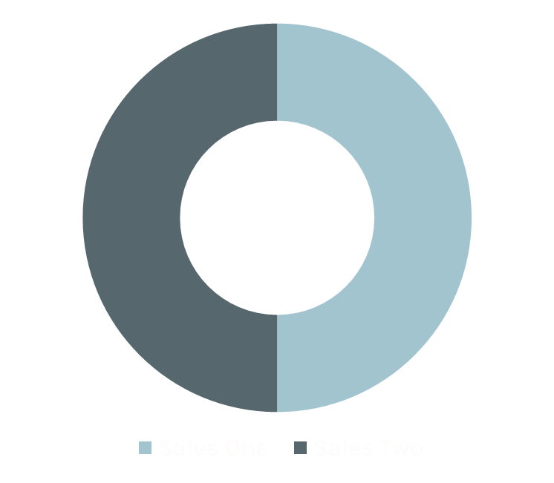
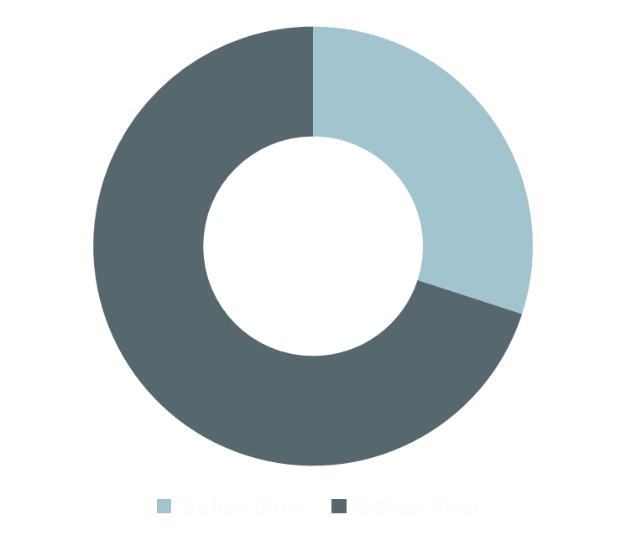
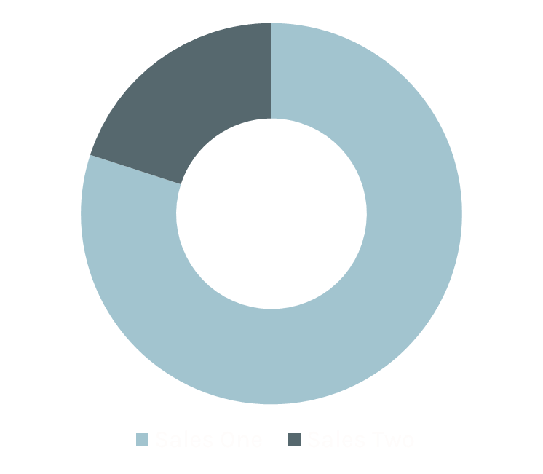
First Trimester Sales Report
Sales status in current situation
Month 1
Month 2
Month 3
Slide 2

Slide 4
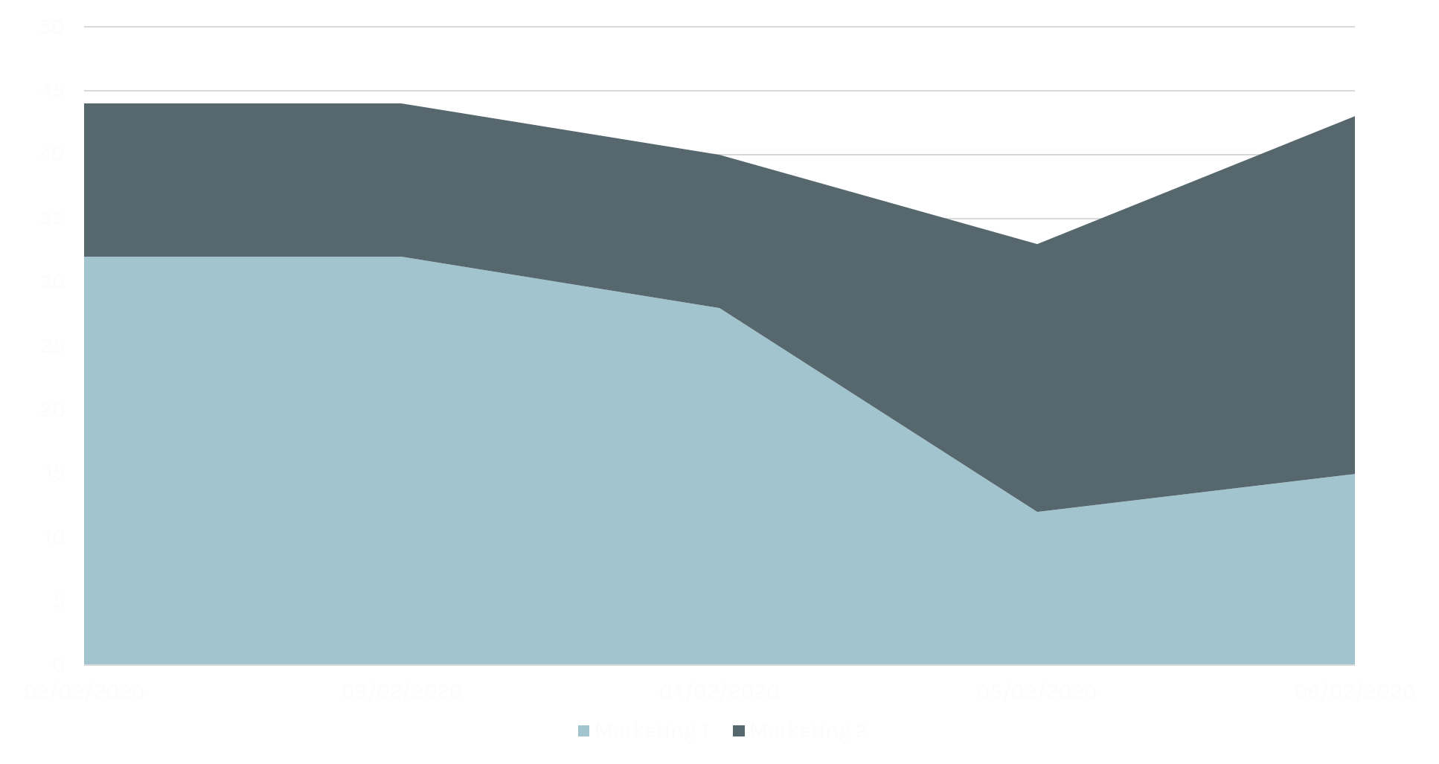

PROFESSIONAL
INFOGRAPHIC
STATISTIC
Marketing Spread
How far the product reaches the customer
Slide 3

Slide 5
The Analysis
S
STRENGTH
W
WEAKNESS
The warmest greeting upon you on this beautiful and fateful day, may the blessing of the Lord be upon us every time and every day.
The warmest greeting upon you on this beautiful and fateful day, may the blessing of the Lord be upon us every time and every day.
O
OPPORTUNITIES
T
THREATS
The warmest greeting upon you on this beautiful and fateful day, may the blessing of the Lord be upon us every time and every day.
The warmest greeting upon you on this beautiful and fateful day, may the blessing of the Lord be upon us every time and every day.

Slide 6



Pricing Plan
Pricing plan for the next product batches
Slide 5
Small Package
Medium Package
Large Package
50
95
125
gr
gr
gr
Price Range
Price Range
Price Range
$7 - $10
$15 - $19
$22 - $26

Slide 7






Sales Development Programs
What The Company Should Do To Support The Sales
Sales Support
Hands on Practice
Pipeline Management
Pitch Practice
Strategic Selling
System & Tools
Objection Handling
Consultative Sales
Sales Coaches
Negotiation Skills
Slide 6
www.reallygreatsite.com

Slide 8
Business Timeline
Slide 7
2018
2019
2020
2021
2022
Establishment
Fundraising
First products on the market
Gain profit $3M
Second batch of product production

Slide 9


Project of New Product
How we develop new products from the beginning till the end
Slide 8
MONTH 2
MONTH 4
Design
Sell
MONTH 1
MONTH 3
Research
Production

Slide 10
Keep in Touch with Us
123 Anywhere St., Any City, ST 12345
+123-456-7890
hello@reallygreatsite.com
www.reallygreatsite.com
Last Slide
2022
@reallygreatsite

